Slide 1
50-300mm F/4.5-6.3 Di III VC VXD for Sony full-frame mirrorless
- Model A069 -

Slide 2
Background of development
The 70-300mm has been a popular focal length for telephoto zoom lenses since the DSLR era because of its balanced good size and price.
Based on the concept of "the first telephoto lens”, which is for those who want to enjoy telephoto shooting casually, TAMRON released the lightweight and affordable price lens, the 70-300mm F/4.5-6.3 Di III RXD (Model A047) for Sony E-mount, in October 2020.
The 50-300mm F/4.5-6.3 Di III VC VXD (Model A069) is targeted at users who are more concerned with image quality and want to create artworks. Therefore, this model was developed as a compact, high image quality design with a high-speed AF and VC (Vibration Compensation) mechanism.
One of the features of this lens is the extended focal length at the wide end, from the conventional 70mm to 50mm.
This makes it a highly convenient lens that covers the standard focal length and expands the range of subjects that can be photographed.
If users also have the 17-50mm F/4 Di III VXD (Model A068), they can cover the focal length from ultra wide-angle to telephoto in one compact package.
The filter diameter of both models is φ67mm. This makes it attractive to share filters such as PL filters that are essential for landscape photography.

Slide 3
Concept:
50-300mm F/4.5-6.3 Di III VC VXD for Sony full-frame mirrorless
For those who feel 70mm is somewhat tight.
The 300mm telephoto zoom lens, starting from 50mm at the wide end.
● The high image quality Ultra Multi Focal Length zoom lens, covering from the standard 50mm to 300mm
● Lightest weight in its class* at just 665g (23.5oz)
● VXD (Voice-coil eXtreme-torque Drive) linear motor mechanism for High speed and high precision AF,
and VC mechanism for stability with videography in mind
● Unified 67mm filter diameter
* Among full-frame mirrorless compatible 300mm telephoto zoom lenses equipped with a vibration compensation (As of May 2024: TAMRON)
Target users: 1. Middle to high amateurs seeking for
a light weight, VC mechanism, and high-speed AF
2. Users who need both high-image quality and 300mm at tele side
Target cameras: α7 IV α7R Ⅳ, α7C, α7CR

Slide 4
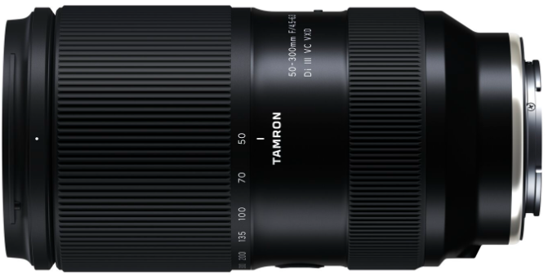
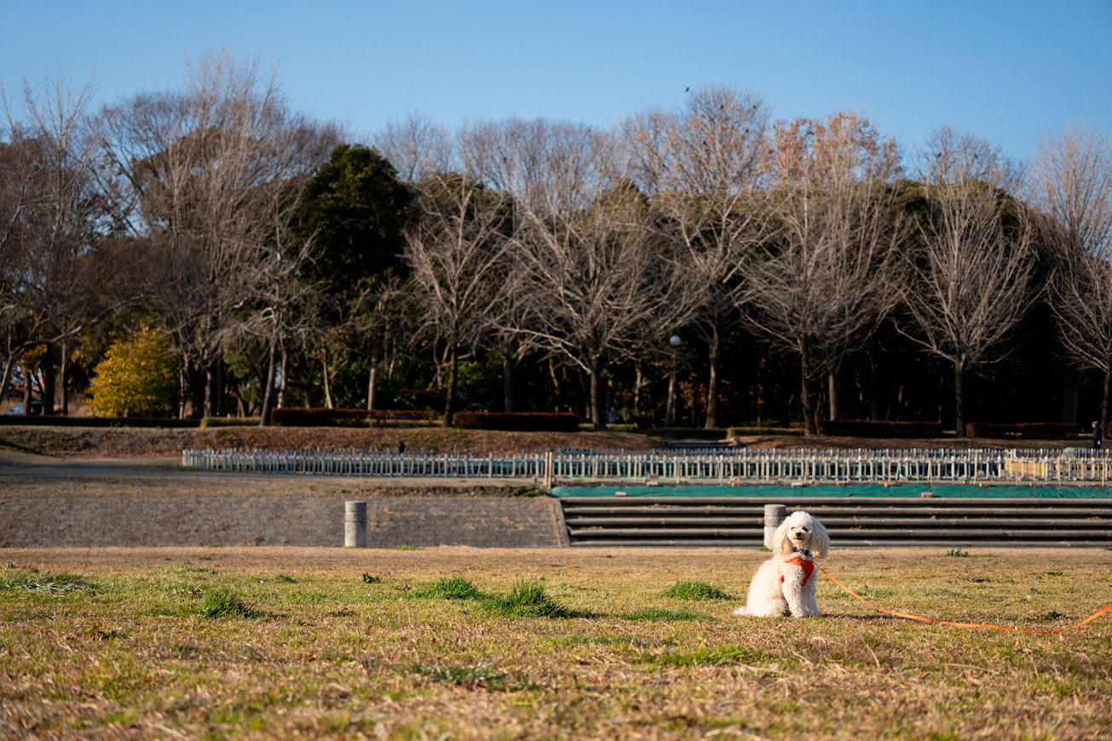


The high image quality Ultra Multi Focal Length zoom lens,
covering from 50mm (“standard” range) to 300mm (“telephoto” range)
The 50-300mm F4.5-6.3 VC provides a wide 50mm starting option in spite of the same sense of size as a 70-300mm and uncompromised image quality. This extra focal length range expands the possibilities for photographic expression while allowing photographers to work more freely for a variety of subjects and situations.
50mm
70mm
300mm

Slide 5
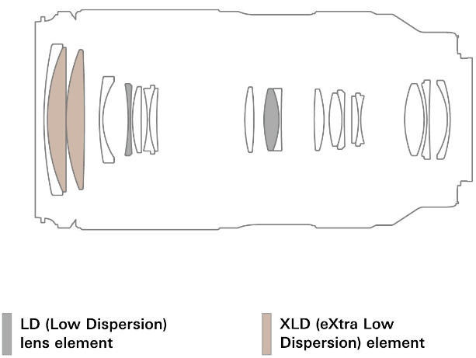
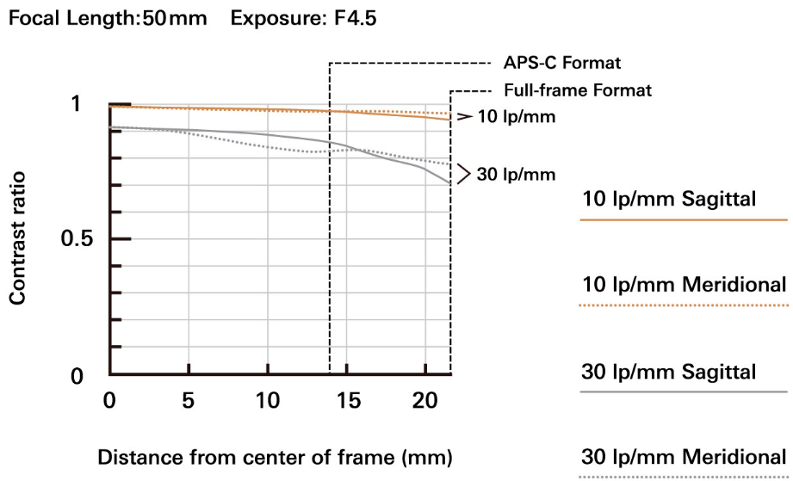
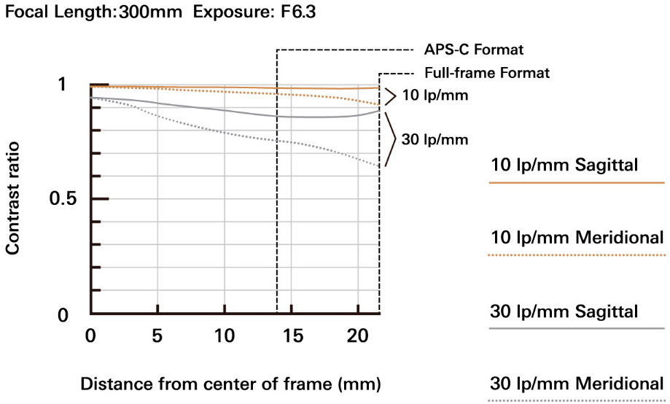
Supreme high image quality throughout the entire zoom range
■Optical Construction: 19 elements in 14 groups
The 50-300mm F4.5-6.3 VC was designed in pursuit of high image quality and high-resolution performance throughout the entire zoom range. The lens has an optical construction of 19 elements in 14 groups, and a generous and effective arrangement of special lens elements, including two XLD (eXtra Low Dispersion) and two LD (Low Dispersion) lens elements, that efficiently control aberrations such as chromatic aberrations. Additionally, BBAR-G2 (Broad-Band Anti-Reflection Generation 2) Coating suppresses ghosting and flare to let you capture every detail of your subject, even under backlit conditions. High levels of sharpness and clarity enable you to create the images you envision. This new TAMRON zoom also features smooth and rich gradation and beautifully soft bokeh. We can confidently recommend for outdoor portrait photography and other situations where you want to blur the background to make your subject stand out.
■MTF

Slide 6

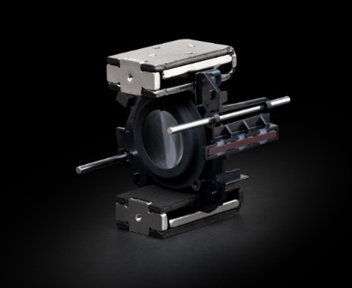
High-speed, high-precision AF with
excellent moving subject tracking performance
The AF drive of the 50-300mm F4.5-6.3 VC uses TAMRON's VXD linear motor focus mechanism. This AF system allows comfortable focusing from the MOD (Minimum Object Distance) through infinity with high-speed and high-precision performance that represents the highest level in TAMRON’s history. Tracking performance for moving subjects is also outstanding, and tracks subjects moving in unpredictable ways. These features ensure you can capture once-in-a-lifetime photo opportunities without missing the shot.
In addition, because the quietness offered by the linear motor system provides nearly silent operation, reducing the noise from vibration and focus driving, the lens can also be used with confidence when shooting still images or filming in environments where quietness is required.
VXD: Voice-coil eXtreme-torque Drive
While operating faster than ever before, the drive also maintains positional accuracy down to 0.005mm (0.0002in), less than one-tenth the width of a human hair! Focus tracking has been vastly improved. This ensures that the dramatic, action-packed moments are never missed, whether shooting still photos or video. Additionally, this zoom offers superior quietness, making it ideal for shooting in low-noise environments as the linear motor is structured to reduce the vibrations produced during drive operation (as compared to a conventional drive system).
300mm F6.3 1/5000sec ISO 800

Slide 7

TAMRON’s proprietary VC mechanism for steady shooting
The 50-300mm F4.5-6.3 VC is equipped with TAMRON’s VC mechanism to effectively suppress camera shake that tends to occur when shooting at telephoto ranges, moving subjects and close-up photography. This outstanding stability frees you to concentrate on shooting with peace of mind. As the full-frame equivalent focal length is 75-450mm when shooting with an APS-C camera, the VC mechanism especially shows its strengths at the telephoto side. The VC can also reduce the degradation of picture quality when shooting in situations where camera shake is likely to occur, such as dimly lit interiors, moody indoor portraits, and low-light conditions such as early morning or evening landscapes.
Moreover, using AI technologies at focal lengths of 100mm or less, the lens selects the appropriate compensation characteristics for videography to powerfully support the inherent high optical performance of the lens.
300mm F20 1/30sec ISO 50

Slide 8

Achieves a maximum magnification ratio of 1:2 at 50mm,
offering half-macro shooting
This TAMRON zoom lens delivers excellent close-up shooting performance with an MOD of 0.22m (8.7in) for a maximum magnification ratio of 1:2 at the 50mm wide end. This lets you get extremely close to subjects and enjoy half-macro shooting. Even at the 300mm telephoto end, the MOD is just 0.9m (35.4in), achieving a maximum magnification ratio of 1:3.1. This feature lets you fully enjoy image compositions unique to the 50-300mm F4.5-6.3 VC and allows you to capture your subjects more creatively.
50mm F4.5 1/80sec ISO 800

Slide 9
MOD and max. magnification ratio
Focal length | 50mm | 70mm | 100mm | 200mm | 300mm
MOD | 0.22m (8.7in) | 0.25m (9.8in) | 0.34m (13.4in) | 0.76m (29.9in) | 0.9m (35.4in)
Magnification ratio | 1:2 | 1:2.1 | 1:2.6 | 1:3.7 | 1:3.1

Slide 10
The lightest weight in its class at just 665g (23.5oz)
Although equipped with the VC mechanism, this telephoto zoom lens maintains the compactness of achieving a class-leading compact size with a weight of 665g (23.5oz).
With these outstanding portability and convenience, you can enjoy greater versatility and highly immersive shooting experiences.
665g (23.5oz)

Slide 11
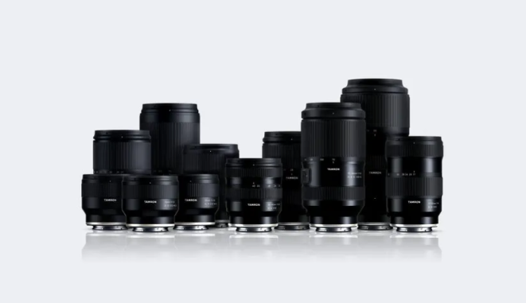
Unified 67mm filter diameter
We also offer a large lineup of φ67mm filter diameters for mirrorless lenses to allow users to enjoy with a wider range of lenses. All lenses in this series are designed to be compact and lightweight, suitable for use with mirrorless cameras and have the same φ67mm filter diameter. In addition to providing excellent portability even when carrying multiple lenses at the same time. And the entire lineup is highly convenient because PL filters and other filters can be shared, and additionally this eliminates the need to search for caps with different diameters when switching lenses.
Mirrorless Lenses with 67mm filter diameter >

Slide 12
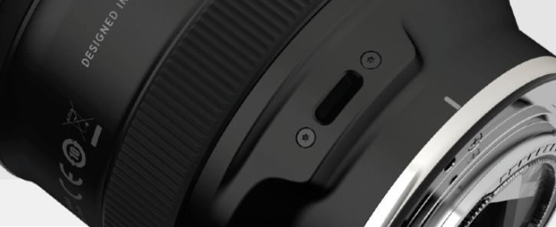
Compatible with TAMRON Lens UtilityTM software
The 50-300mm F4.5-6.3 VC is compatible with the dedicated TAMRON Lens Utility software (for computers and Android™ ¹ OS) that was developed in-house by TAMRON². This software allows various lenses and camera settings to be assigned to the Focus Set Button located on the lens. Also, the lens' firmware³ can be updated to the latest version. Users may customize functions for various still photography and videography shooting styles, thereby providing a more personalized and fulfilling shooting experience.
1 Android is a trademark of Google LLC.
2 To connect your computer and lens, use the TAMRON Connection Cable (USB Type-A to Type-C/ Model CC-150, or USB Type-C to Type-C/ Model CC-350) sold separately.
To connect your smartphone and lens, use the TAMRON Connection Cable (USB Type-C to Type-C/ Model CC-350) sold separately.
3 Lens firmware updates are not supported with the mobile version. Performing firmware updates requires the TAMRON Lens Utility for computers.
Functions of TAMRON Lens Utility for 50-300mm F4.5-6.3 VC
［ Connector Port ］
- Focus Set Button settings
  A-B Focus: Set 2 focus positions (A and B) and make the focus automatically shift between A and B
  Focus Preset: Set your desired focus position and move the focus to the recorded point by a single button press
  Select AF/MF: Select AF and MF function using the Focus Set Button
  Focus Limiter: Allows you to limit the focus search range of the AF and switch Full/Limit
  Focus Ring Function (Focus/Aperture): Switch Focus Ring Function from focus adjustment to aperture adjustment
  Assign function from the camera: Assign custom functions from the camera body to the Focus Set Button
  * If you do not need to use the function or do not want to accidentally activate the function, the function of Focus Set Button can be cleared
  Focus Stopper: Limit the MF travel range between any two focal points that have been recorded beforehand
  Astro-Focus Lock (Astro FC-L): Focus point will automatically be fixed at infinity
- Focus Ring settings
  MF Ring Rotation: Change the rotation direction of the focus ring
  MF Method: Choose the method of focus operation when using the focus ring
- Firmware update
NEW

Slide 13
Specifications
Model | 50-300mm F/4.5-6.3 Di III VC VXD (Model A069) for Sony E-mount
Focal Length | 50-300mm
Angle of View (diagonal) | 46°48′- 8°15′ <for full-frame mirrorless format＞
Maximum Aperture | F4.5-6.3
Minimum Aperture | F22-32
Aperture Blades | 9 (circular diaphragm)
Focus Actuator | VXD linear motor focus mechanism (IF)
MOD | WIDE - 0.22m (8.7in)
 | TELE - 0.9m (35.4in)
Maximum Magnification Ratio | WIDE - 1:2
 | TELE - 1:3.1
Optical Construction | 19 elements in 14 groups 2 XLD, 2 LD lens elements
Coating | BBAR-G2 Coating
 | Fluorine Coating
Vibration Compensation | 〇
Moisture-Resistant Construction | 〇
Filter Size | φ67mm
Measurement | Maximum diameter: φ78mm
 | Length: 150mm (5.9in)
 | Weight: 665g (23.5oz)
Included Accessories | Flower-shaped hood, Front cap, Rear cap
Filter diameter of 67mm
Zoom ring
Focus Set Button
Focus ring
Connector Port
Zoom Lock switch

Slide 14
EOF

Slide 15
Appendix

Slide 16
Appendix: Specification comparison
Product Name | 50-300ｍｍ F/4.5-6.3 Di III VC VXD (Model A069) |  | Reference 70-300ｍｍ F/4.5-6.3 Di III RXD (Model A047) | Competitor A 70-300mm F4-5.6
Focal Length (mm) | 50-300 | ◎ | 70-300 | 70-300
Maximum Aperture | 4.5-6.3 | △ | 4.5-6.3 | 4-5.6
Optical Performance | ◎ | ◎ | 〇 | ◎
MOD (m/in) | 0.22-0.9 / 8.7-35.4 | ◎ | 0.8-1.5/31.5-59.1 | 0.9/35.4
Max. Magnification Ratio | 1:2-1:3.1 | ◎ | 1:9.4 -1:5.1 | 1:3.2
Aperture Blades | 9 (circular) | - | 7 (circular) | 9 (circular)
Filter Size (mm) | 67 | ◎ | 67 | 72
Max. Diameter (mm) | 78 | ◎ | 77 | 84
Length (mm/in) | 150/5.9 | △ | 147.5/5.8 | 143.5/5.6
Weight (g/oz) | 665/23.5 | ◎ | 585/20.6 | 854/30.1
Vibration Compensation | 〇 | - | - | 〇
Buttons | Focus Set Button | - | - | FHL
AF/MF Switch | - | × | - | 〇
Fn Switch | - | × | - | Limit switch
Image Stabilizer Switch | Setting at camera body side | × | - | 〇
Etc. | Connector Port | ◎ | - | -

Slide 17
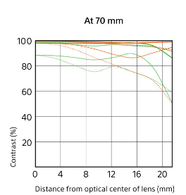
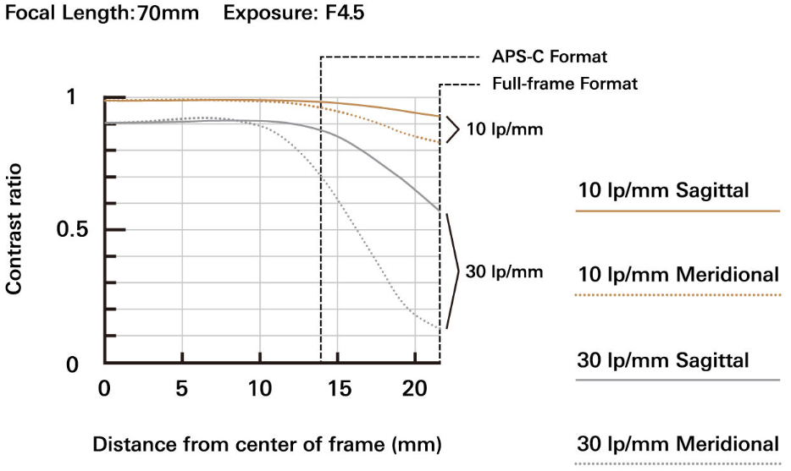
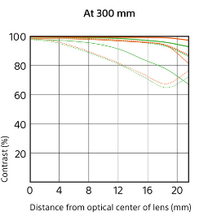
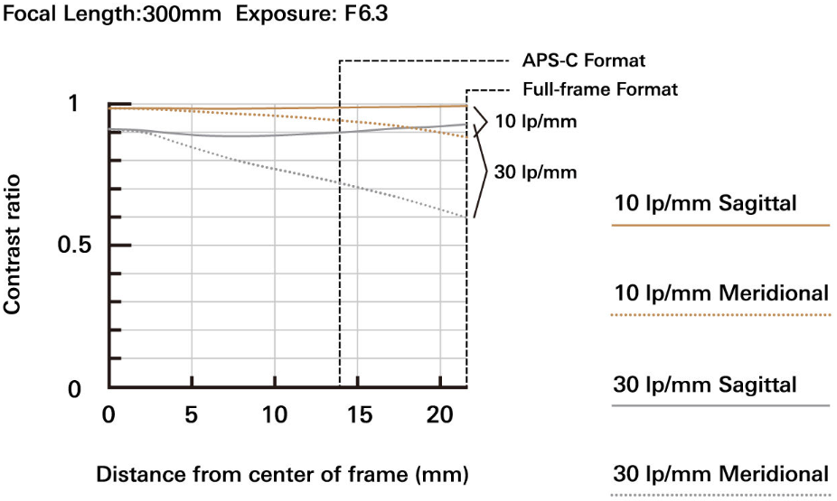

Appendix: Optical performance comparison
50-300mm F4.5-6.3 VC
(Model A069)
70-300mm F4.5-6.3
(Model A047)
Competitor A
70-300mm

Slide 18

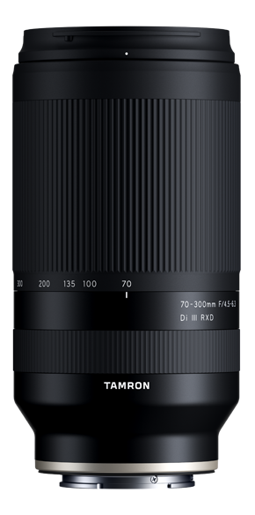
Appendix: Size comparison
50-300ｍｍ F/4.5-6.3
Di III VC VXD (Model A069)
70-300ｍｍ F/4.5-6.3
Di III RXD (Model A047)
Competitor A
70-300mm F4-5.6

Slide 19
Appendix: Recommended combinations
Covering the focal length from 17mm (ultra wide-angle) to 300mm (telephoto) with two lenses
17mm
50mm
300mm
F4
F4.5-6.3
460g (16.2oz)
665g (23.5oz)
1,125g (39.7oz)

Slide 20
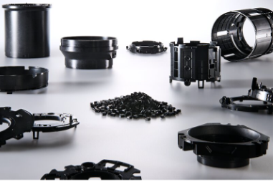
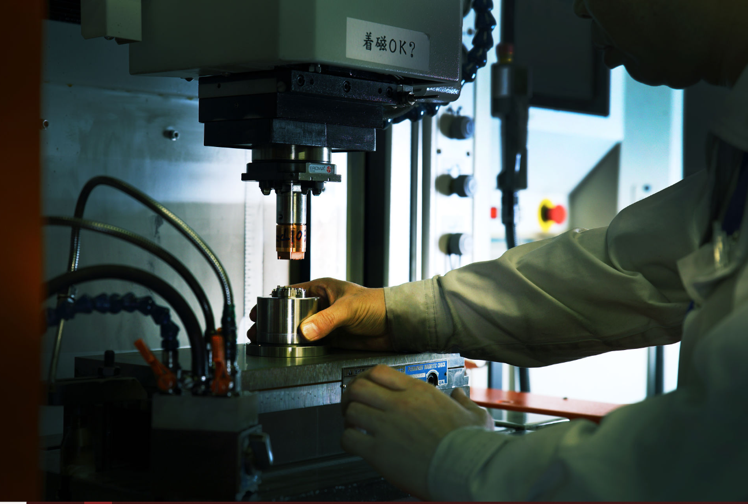
TAMRON’S pursuit to robust engineering plastic design
Lightweight and durable polycarbonate resin
TAMRON uses polycarbonate resin (engineering plastic) for our lens barrels of mirrorless cameras. This material is extremely reliable, lightweight, and durable, and also broadly used for such as racing car bodies and F1 racer‘s helmets. TAMRON selects the best material from various grades of polycarbonate and selects a material with thermal expansion/shrinkage comparable to that of aluminum in structurally critical areas. And also, these materials must be carefully determined. These processes allow the product to be comfortably used in a variety of environments.
The environment and facilities for manufacturing optical parts are essential to the quality of the parts. TAMRON holds all the equipment and environment in-house to manufacture high quality parts. The combination of the most advanced measuring system and the outstanding craftsmanship molding skills make the most of the selected materials, resulting in extremely high-precision, micron-level parts.
These efforts are based on TAMRON’s extensive know-how and experience in the manufacture of lenses for industrial as well as photographic lenses. Therefore, these lead to highly reliable products for camera enthusiasts and professional photographers.

Slide 21
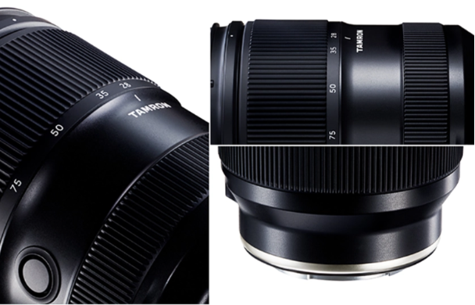
Ergonomic design
with aesthetic appeal and functionality
TAMRON develops lenses for mirrorless cameras under the brand statement "Human Focus," aiming to create lenses that are always close to our users. The ergonomic design is based on a thorough investigation of "what makes people feel comfortable" and is focused on ease of use.
Reviewing each part and component down to the finest details, we continue to pursue the development of the best products, including the lens body with a comfortable, uneven shape that fits snugly and naturally in the hand, redesigned striped pattern on the rubber focusing and zoom rings with the appropriate amount of convexity calculated, and the metal parts for the internal mechanism that ensure smooth operability. The design with operability and texture in mind provides a comfortable shooting experience for the users.
The recessed switch box and Focus Set Button have an unobtrusive, contoured design that smoothly guides the fingers intuitively. The sloped bevel around the slide switch draws your finger naturally to the right position. To prevent accidental operation, the switches have a low profile. Taken altogether, these enhancements provide a more comfortable user experience.
The surface of the lens exterior is shiny black, and its improved abrasion resistance makes the lens harder to scratch and resists fingerprints. The smooth touch provides users a sense of trust and reliability through the experience.
The TAMRON brand ring, the warm and captivating glow of the luminous gold ring connecting the lens to the camera accentuates the products, distinguishing itself as a symbol of excellence in engineering and design and marking our commitment to deliver joy and to inspire creativity.
TAMRON will remain user-centric and study people while designing and manufacturing lenses so that users around the world can fully continue to enjoy photography in their own way.
*The switch box and Focus Set Button availability varies depending on the model.

Slide 22
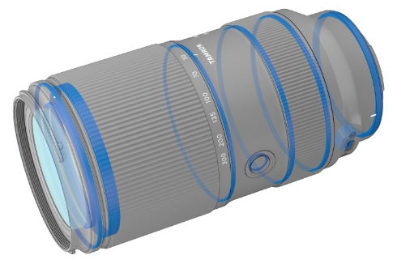
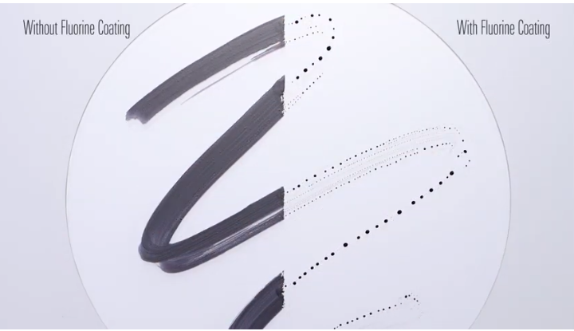
Appendix: Additional features
Focus Set Button
Moisture-Resistant Construction
For greater protection when shooting outdoors, leak-resistant seals throughout the lens barrel help protect your equipment. Also, the Connector Port is the water-proofed USB Type-C variety.
Zoom Lock switch
This prevents the unwanted extension of the lens barrel due to the weight of the lens during transportation.
Fluorine Coating
The front surface of the lens element is coated with a protective fluorine compound that is water- and oil- repellant. The lens surface is easier to wipe clean and is less vulnerable to the damaging effects of dirt, dust, moisture and fingerprints.
Developed based on the specifications
of E-mount
This product is developed, manufactured and sold based on the specifications of E-mount disclosed under license agreement with Sony Corporation.
It is compatible with many of the advanced features that are specific to Sony mirrorless cameras.
- Eye AF
- Fast-Hybrid AF
- In-camera lens correction (shading, chromatic aberration, distortion)
- Direct Manual Focus (DMF)
- AF Assist

